Slide 1
Child Tax Credit Navigator Training
How to Access the Non-filer Portal & CTC Update Portal
Roxy Caines
Center on Budget & Policy Priorities
Janne Huang
Center on Budget & Policy Priorities
Courtney O’Reilly
Code for America
Christine Tran
Center on Budget & Policy Priorities
July 14, 2021
www.eitcoutreach.org

Slide 2
Center on Budget and Policy Priorities
Nonpartisan research and policy institute
We pursue federal and state policies designed both to reduce poverty and inequality in equitable and effective ways.
www.cbpp.org

Slide 3
Get It Back Campaign
National effort to connect eligible people to tax benefits
Promote the Earned Income Tax Credit, the Child Tax Credit, free tax preparation, and other tax benefits
Work with a network of diverse partners
www.taxcoutreach.org

Slide 4
Today
CTC Expansion Basics
The Problem & How You Can Help
CTC Navigators
IRS Non-Filer Portal Walkthrough & Live Demo
IRS Child Tax Credit Update Portal Walkthrough
Q&A

Slide 5
Child Tax Credit Expansion Basics

Slide 6
CTC Fast Facts
Under a recent federal law, almost every family can receive money from the Child Tax Credit. This includes families that haven’t filed a tax return and those without recent income.
Each qualifying household is eligible to receive $3,600 for each child under 6 years old, and $3,000 for each child between 6 and 17 years old.
Families can receive half of the payments in 2021 and the other half in 2022.
Anyone who has a child with a social security number is eligible, even if they do not have a social security number themselves.
The credit is not a loan.

Slide 7

Impact
Reduces child poverty by more than 40%. Larger reductions for Black, Hispanic, & Native American children and children in deep poverty
Advocates working to make expansion permanent

Slide 8
Comparison
 | $2,000 CTC (current) | Expanded CTC (new)
Age | Children age 16 and under can qualify | Children age 17 and under can qualify
Credit Amount | $2,000 per child | $3,000 per child and $3,600 for children under the age of 6
Refund | Up to $1,400 per child is refundable | Fully refundable
Income | You must have earned income more than $2,500 to qualify for the refundable part of the credit | No income requirement, you can have zero income and still qualify for the full credit amount per child
Advance Payments | No advance payments | Monthly advance payments between July to December 2021
Phase Out Rate | The CTC amount starts to decrease at $200,000 for single filers and heads of households ($400,000 for married couples) | The CTC amount starts to decrease at $75,000 for single filers ($150,000 for married couples and $112,500 for heads of households)

Slide 9
The Problem & How You Can Help

Slide 10
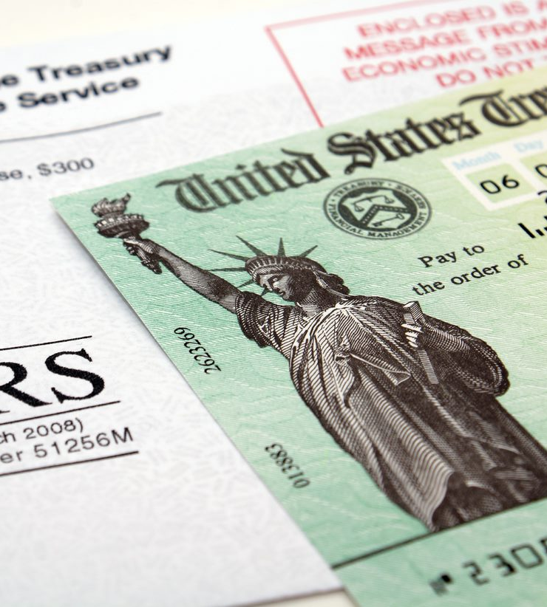
The Problem
Families who filed 2019 or 2020 taxes or used the non-filer form will get automatic payments if they claimed their kids
The families who haven’t filed yet face the most barriers
  Haven’t received stimulus
  Very low-income
  Likely experience technology challenges and have questions
  Need help getting the credit
VITA sites are swamped and at low-capacity

Slide 11


The Solution
Help non-filers submit their info to the IRS:
  Use the Non-filer Portal (simplified 2020 tax return) OR
  File a (full) 2020 tax return

Slide 12
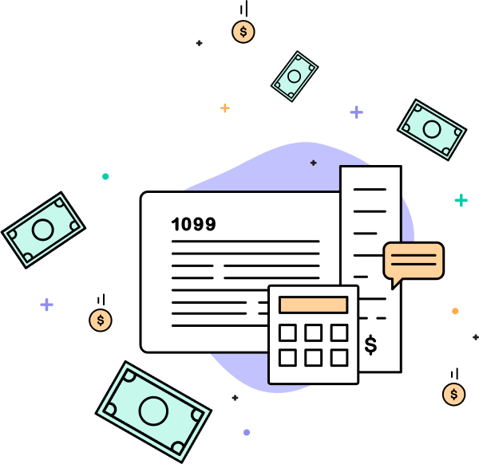
GetCTC.org Navigator
7/14/2021

Slide 13
Understand the navigator role
Determine client’s appropriate next steps
Learn about next steps and additional resources
Learning Outcomes

Slide 14

Code for America is a nonprofit organization that partners with government to strengthen the delivery of public services through human-centered technology.

Slide 15
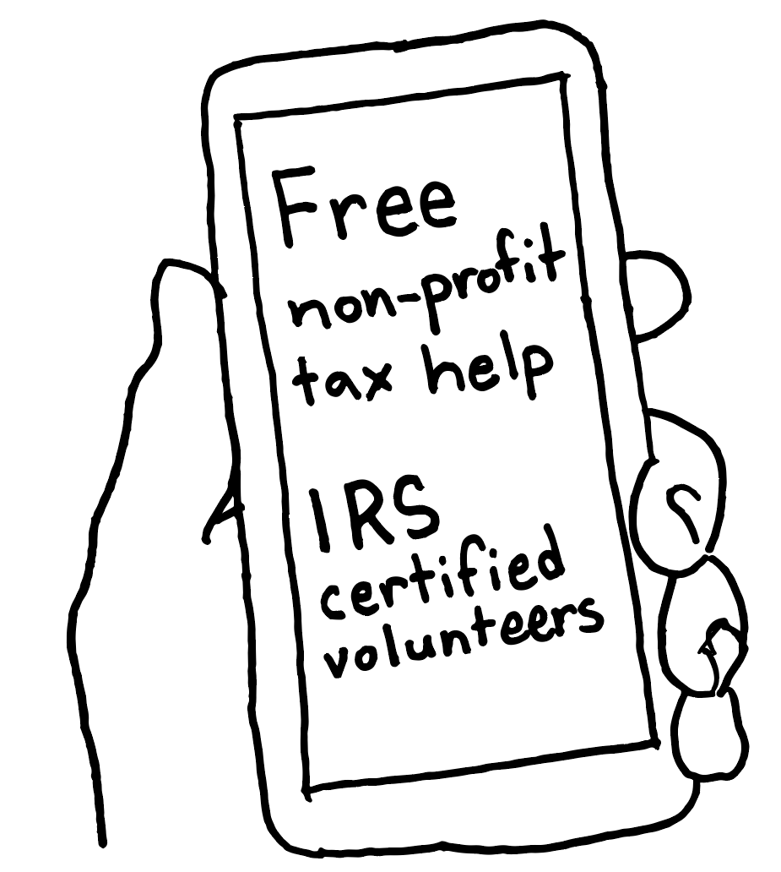
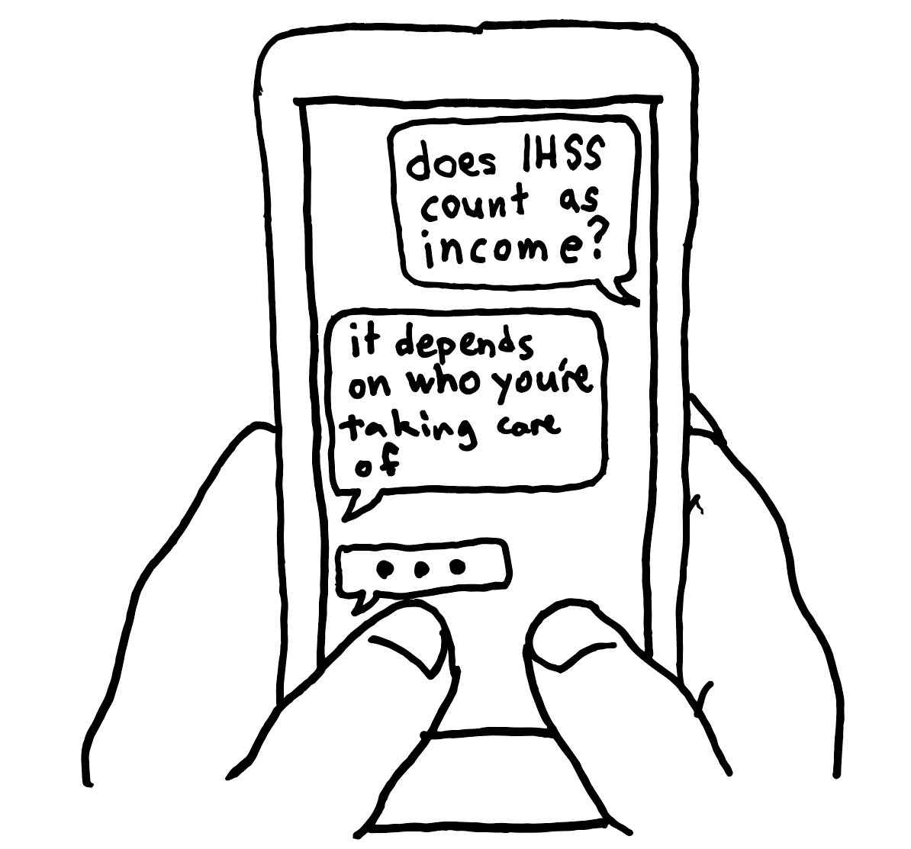
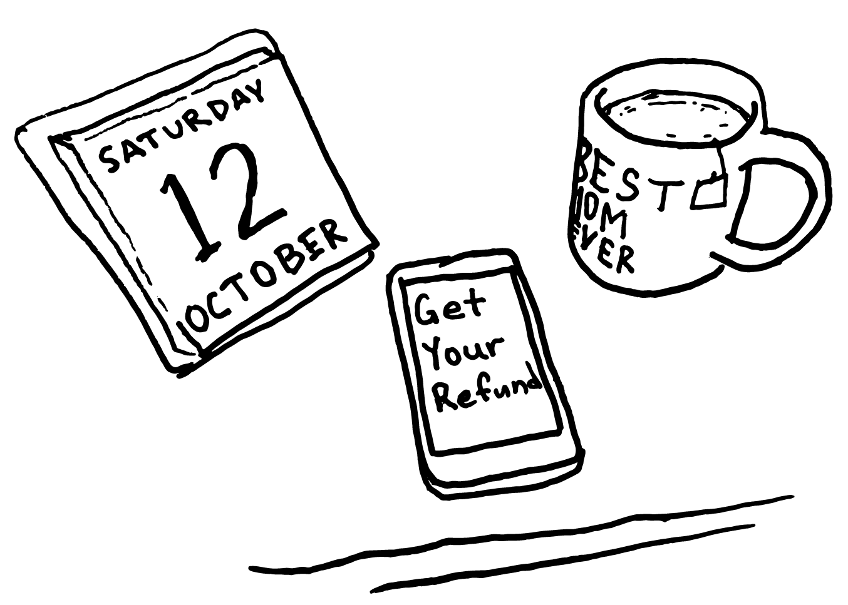
Why navigators are needed
Outreach alone is not enough to overcome access challenges, but trusted navigators with access to the right resources can make a huge difference.

Slide 16
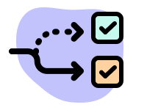
Navigators are trusted, community-based guides that help marginalized non-filers utilize IRS tools, understand and complete the process of filing their taxes, and navigate additional challenges related to accessing critical tax benefits, including but not limited to the AdvCTC, EITC, EIPs, and state tax credits.
What is a navigator?

Slide 17
What types of assistance can navigators provide?
Outreach and trust-building
Answering basic questions about tax benefits
Determining which tax benefits a client may be eligible for
Determining what next steps a client needs to take (if any)
Assisting the client with completing action steps

Slide 18



How do they provide this assistance?
In-person
Over the phone
Online

Slide 19

Best Practices for Navigators
Build trust around tools and process
Familiarize yourself with the resources
Help clients access necessary documents
Be accessible to your intended audience
Provide access and assistance with tech
Ask straightforward questions

Slide 20
No action needed (most likely)
IRS CTC Update Portal
IRS Non-Filer Sign-Up Tool
GetYourRefund.org full service
Determining a Client’s Next Steps to
Claim the AdvCTC

Slide 21



What does your client need to do to access their benefits?
Most families who received a stimulus check for their child do not need to take any action to receive the AdvCTC or EIP3.
Simplified filing/ IRS non-filer tool
Filing a full return
IRS Child Tax Credit Update Portal
Not sure?
Get Help at GetCTC.org
Simple form for claiming EIP 1-3 and CTC, but not EITC or state benefits. This is a short version of a federal tax return.
Best option for people with zero income, or low income people who face barriers to filing a full return
Use GetYourRefund to file a full state and federal return for free, and claim all the benefits you are eligible for.
Best option for people with any income who have tax documents
If you have already filed a 2019 or 2020 tax return and you have not had major changes to your household, no additional action is needed.
Use the update portal only to opt out or report significant changes in your family situation.
Read FAQs, link to key IRS tools, and chat with VITA-certified volunteers.
Help clients find the service right for them.

Slide 22
No action needed:
Provide assurance and information
No action needed to claim the AdvCTC if:
Filed
  2019 tax return*,
  2020 tax return,
  EIP non-filer return
No significant changes
Will file a 2021 tax return (in 2022) with similar household and income information
*If they filed 2019 and haven’t filed 2020, they can file non-filer form to provide updated household information

Slide 23
IRS Non-Filer Sign-Up Tool
Purpose:
  File a simple return to claim AdvCTC and EIPs
Use when:
  They have not filed a 2019, 2020, or non-filer return
  They qualify for
    Child Tax Credit
    Have not received full EIP amounts
  They do not have a filing requirement or benefit from filing a return
Site: www.irs.gov/credits-deductions/child-tax-credit-non-filer-sign-up-tool

Slide 24

IRS CTC Update Portal
Purpose:
  Currently:
    Check enrollment status
    Opt out of advanced payments
    View payment history
    Update or add bank information
  Expected updates after launch:
    Make changes to your address
    Make changes to your dependents, marital status and income
Use when:
  They have filed a 2019, 2020, or non-filer form and
  They need to
    Opt-out of advanced payments
    Check payment history
    Update Information
Look for Opt-Out handout, available on the Navigator training page

Slide 25
GetYourRefund.org
Purpose:
  File a complete tax return
Use when:
  They have not filed a tax return (2018-2020)
  They made some earned income during the year or
  They have a filing requirement

Slide 26
Navigator introductory materials
Navigator guides
  Calculating Recovery Rebate Credit
  Reasons to Opt-Out
  Common Rejected Return Reasons and Next Steps
Links to partner guides
  GetCTC
  CBPP guides
Navigator Training Resources

Slide 27
Thank you!
Please stay connected on our Navigator Resource Page: http://www.c4a.me/getctcnavigators navigators@codeforamerica.org

Slide 28
IRS Non-Filer Portal Walkthrough & Demo

Slide 29
What is the IRS Non-Filer Portal?
This portal allows you to:
Register for advance CTC payments
  Submit information about kids and their ages
Claim the first and second stimulus checks as the Recovery Rebate Credit
  if you didn’t get the stimulus checks at all or didn’t get the full amount you are eligible for
Register for the third stimulus check
  Once you submit your information, if you haven’t received your third stimulus check yet, you will automatically get it later in the year
You don’t have to submit bank account information or a permanent address

Slide 30







Getting Started
The Non-filer form takes 15-30 minutes to compete if you have everything listed below.
A computer or cell phone with access to the internet
Full legal name
Your SSN or ITIN and SSNs of your qualifying children
Mailing address
Email address
OPTIONAL:
Bank account and routing number
Date of birth
Notes:
A computer or cell phone with access to the internet: the form does not work well on phones. You’ll need to scroll right and left to complete all the form fields.
Full legal name
Your SSN or ITIN and SSNs of your qualifying children
Date of Birth
Mailing address: If you are unhoused or don’t have a permanent address, ask your local shelter or service provider. If you can’t find one, you can also ask to use a trusted relative’s or friend’s address. The IRS will deliver checks to P.O. boxes.
Email address: If you don’t remember or have the password to your email, you can create a new email address for free through a website like Gmail, Yahoo! Mail, or AOL.
Bank Account direct deposit/routing number (optional): Direct deposit is the quickest and safest way to get your payment. If you don’t have a bank account, you can still get your payment through direct deposit using a prepaid reloadable debit card, CashApp, Venmo, or PayPal, or opening an online bank account. If you cannot use these options, you’ll get your payment as a paper check.

Slide 31
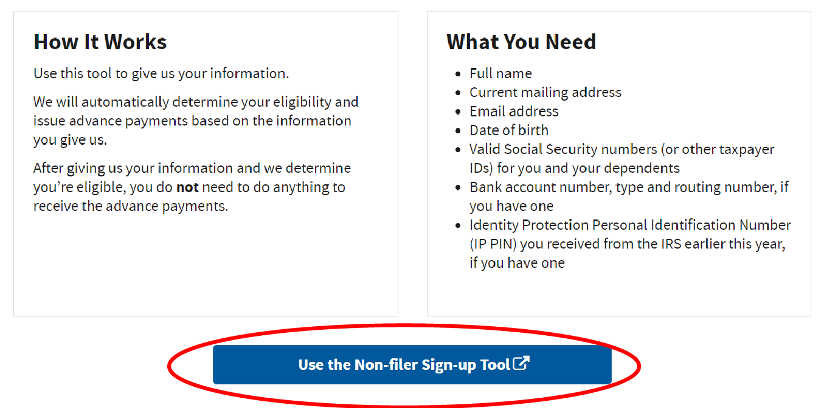
Step 1: Visit the IRS website to access the Non-filer form
Scroll to the bottom of this IRS portal: https://www.irs.gov/credits-deductions/child-tax-credit-non-filer-sign-up-tool
Click the blue “Use the Non-filer Sign-up Tool” button

Slide 32
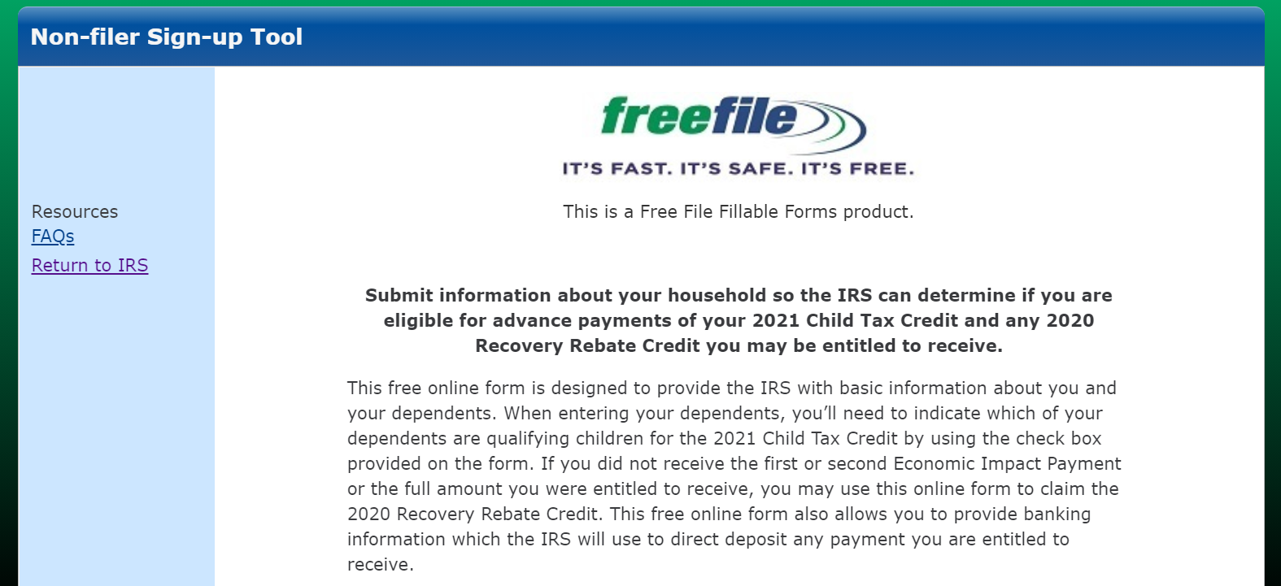
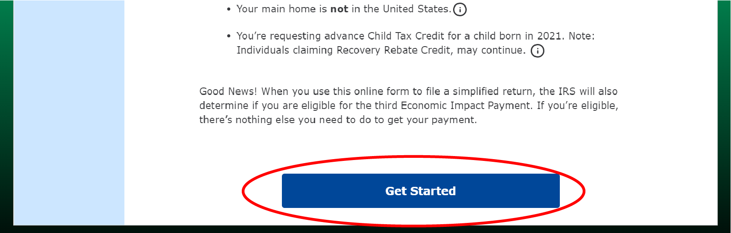
You will be taken to this page: https://www.freefilefillableforms.com/#/fd/childtaxcredit
Click the blue “Get Started” button.

Slide 33
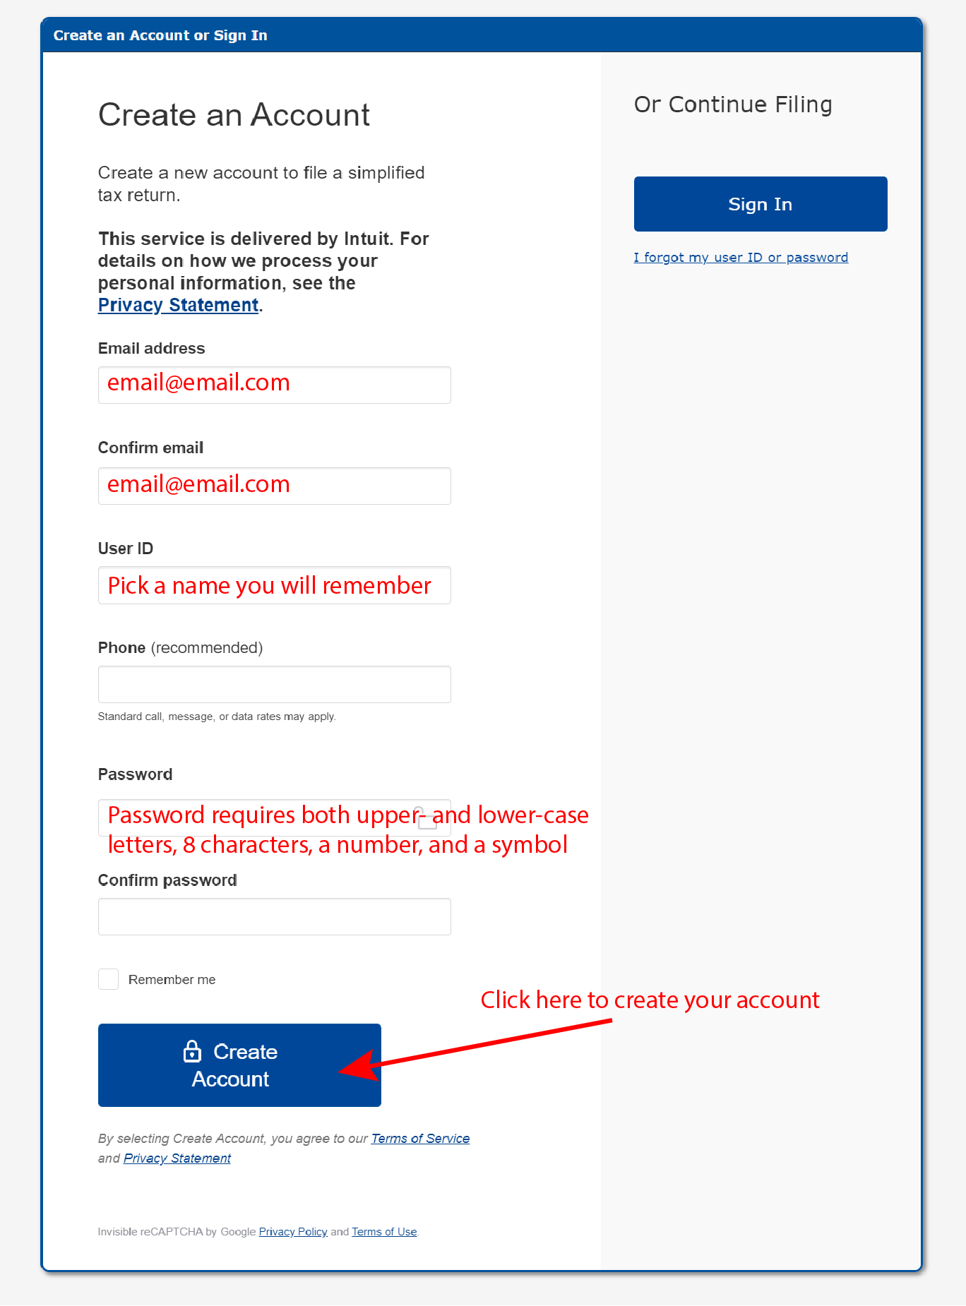
Step 2: Create an account
Fill out the following information to create an account:
Email address: You will need to check your email to verify your address before submitting the form.
User ID
Phone number: while not required, it can be used to help you access your account if you forget your password.
Password: requires both upper- and lower-case letters, 8 characters, a number, and a symbol.

Slide 34
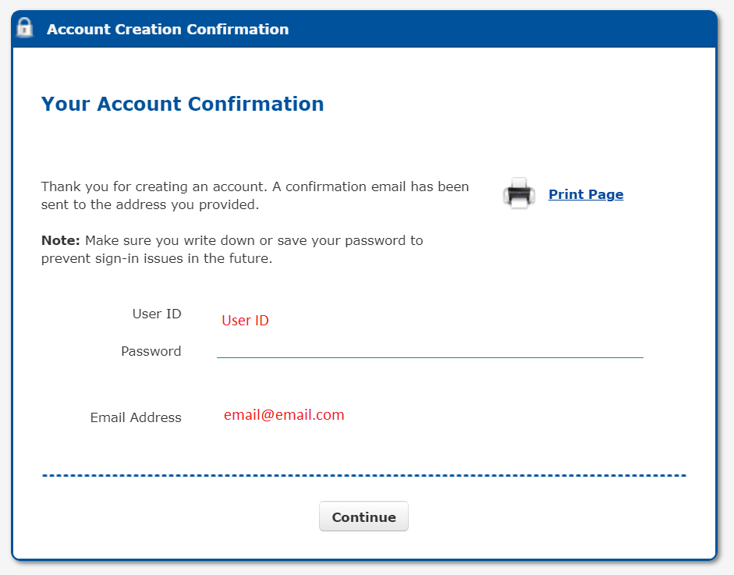
Once you complete the form and click the blue “create account” button, you will see an account confirmation page.
Hit the “Continue” button to begin completing the form.

Slide 35
TIP: Safety feature
If you don’t use the form for 20 minutes, it will time out and you will see the following a message that says “We have logged you out. We do this automatically if you haven’t used Non-Filers: Enter Payment Info in the last 20 minutes.”

Slide 36
Step 3: Fill out filing status, claim dependents, and provide banking information
For “STEP 1. Fill Out Your Tax Forms,” there is required and optional information to complete. Skip the optional fields that do not apply to you.
Required
Optional
Filing Status (Single or Married filing jointly)
First name, middle initial, and last name
Social Security Number (SSN) or Individual Identification Number (ITIN)
Home address
Dependents in 2020: First and last name, SSN, relationship to you. Check the box if they qualify for the CTC.
Note: these fields are required for both you and your spouse if you are married filing jointly. If you have a new qualifying child in 2021, you will be able to provide their information in CTC UP this summer.
Check the box if you or your spouse can be claimed by someone else as a dependent
Recovery Rebate Credit amount: If you didn’t get the full first or second stimulus check, you can enter the amount you are owed.
Bank account routing info: If you leave this blank, your payments will be mailed.
Identity Protection PIN: only include if the IRS provided you a number because you’ve experienced identity theft.

Slide 37
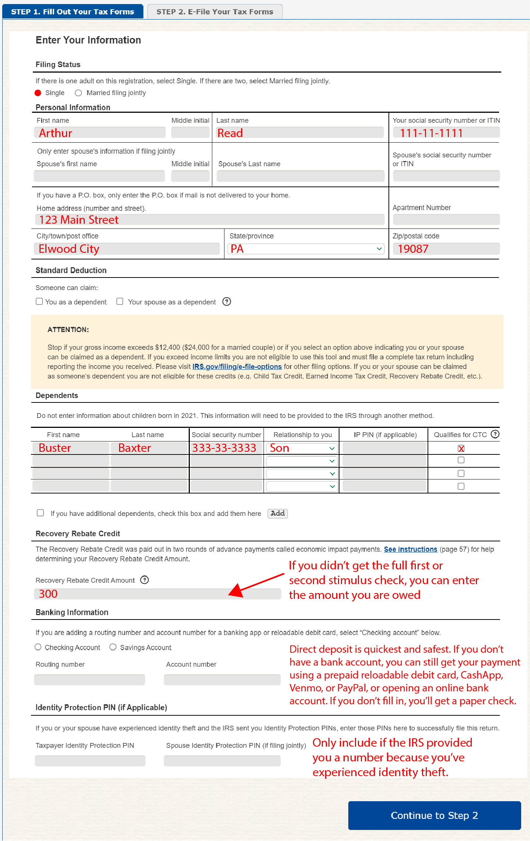
Top
Bottom
Notes:
There are two main buckets on how to help.

Slide 38
TIP: What to know about the Recovery Rebate Credit amount
The Recovery Rebate Credit allows you to get any money that you missed from the FIRST and SECOND stimulus checks.
To determine the Recovery Rebate Credit amount, first identify how much you already received. There are 3 options:
  Refer to the IRS notices that were mailed to you.
    IRS Notice 1444 shows amount received for the 1st stimulus check
    IRS Notice 1444-B shows amount received for the 2nd stimulus check
  Check your bank statements if you had your payments direct deposited.
  Provide the amount based on your memory.
Note: The IRS will correct the amount for you if you make a mistake. This can slightly delay processing. The IRS will notify you of any changes made to your tax return.

Slide 39

TIP: Calculating the Recovery Rebate Credit Example
1. Look up how much you received with your first and second stimulus checks. Add these two amounts.
1st stimulus: $1,200
+
2nd stimulus: $600
----------------------------
$1,800
2. Figure out how much you qualify for. Add the amounts for your first and second stimulus check.
*First stimulus check: $1,200 (single) OR $2,400 (married) + $500 per dependent
*Second stimulus check: $600 (single) OR $1,200 (married) + $600 per dependent
1st stimulus: $1,700
+
2nd stimulus: $1,200
----------------------------
$2,900
First stimulus check calculator
Second stimulus check calculator
3. Finally, subtract the amount you received from the amount you are owed.
Qualify for: $2,900
-
Received: $1,800
----------------------------
Owed $1,100
write this on the Recovery Rebate Credit line

Slide 40
Step 4: Fill out income and personal identification information
For “STEP 2. E-file Your Tax Forms,” there is required and optional information to complete. Skip the optional fields that do not apply to you.
Required
Optional
Personal verification: The form asks for your 2019 Adjusted Gross Income. If you did NOT file taxes last year, enter “0” in the box. Ignore part B which asks for last year’s self-selected signature PIN.
Date
Electronic signature: Instead of signing your name, your signature is a 5-digit PIN number that you create.
Date of birth
Note: these fields are required for you and your spouse if you are married filing jointly.
Cell phone number
Driver’s license or state issued ID number, state, issue date, and expiration date – leave blank if you (or your spouse if married filing jointly) don’t have one

Slide 41
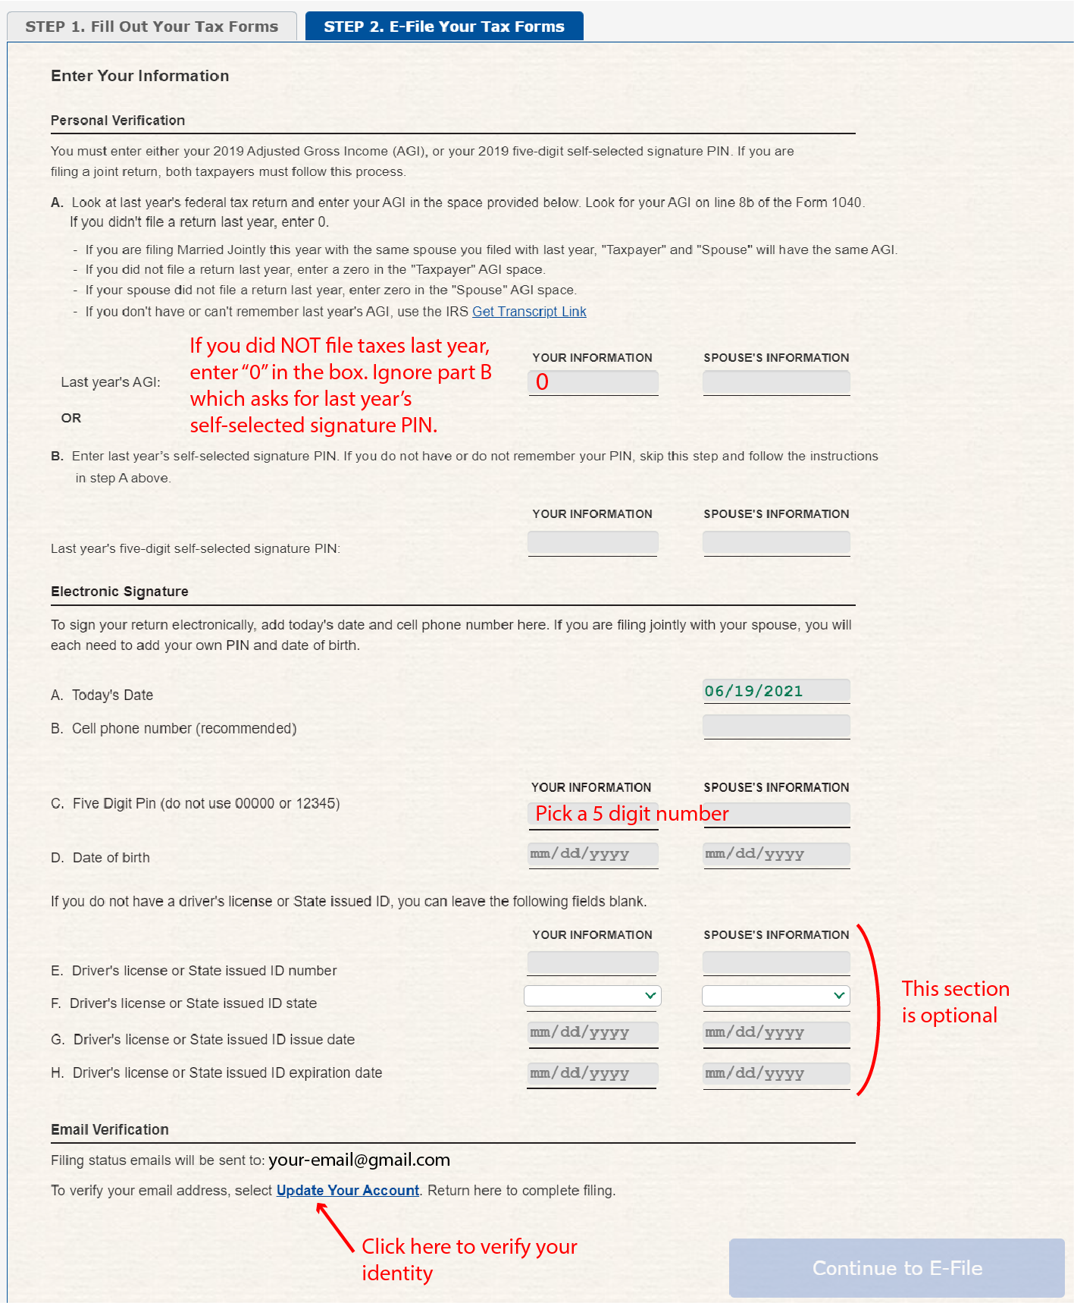
Top
Bottom
Notes:
There are two main buckets on how to help.

Slide 42

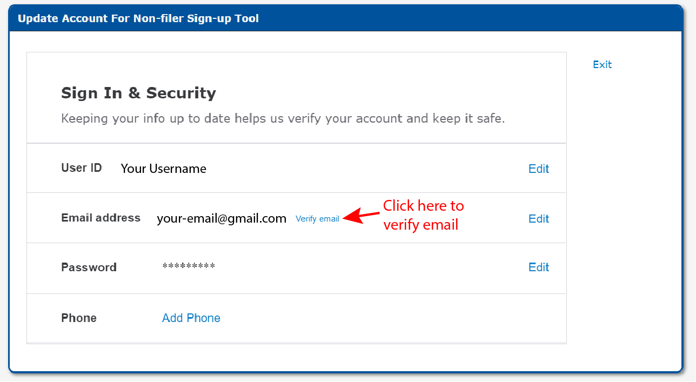
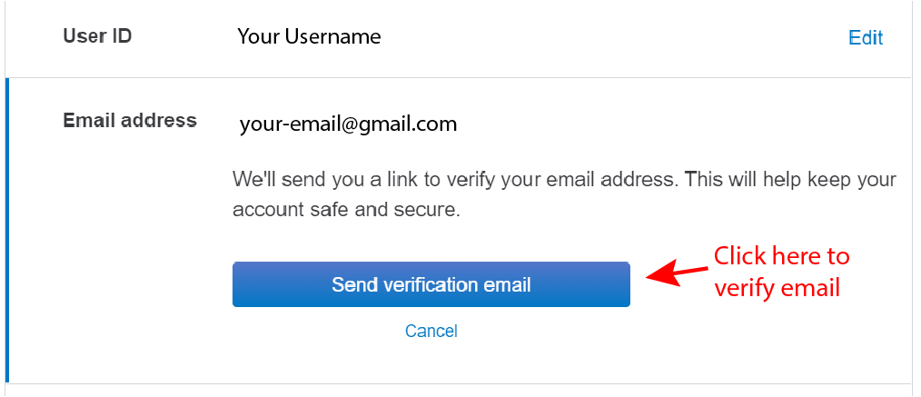
Step 5: Verify your email
Before you can submit your form, you must verify your email address. On “STEP 2 E-file your tax forms,” scroll to the bottom of the page. Click the “Update Your Account” link.
That will take you to the screen below. Click the “Verify email” link. Then click on “Send verification email.”

Slide 43
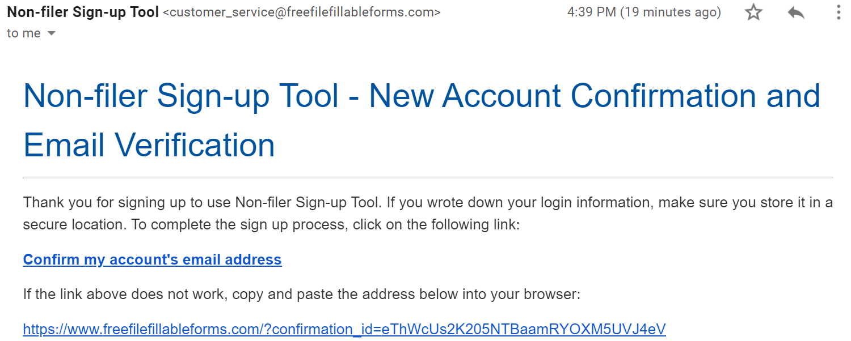
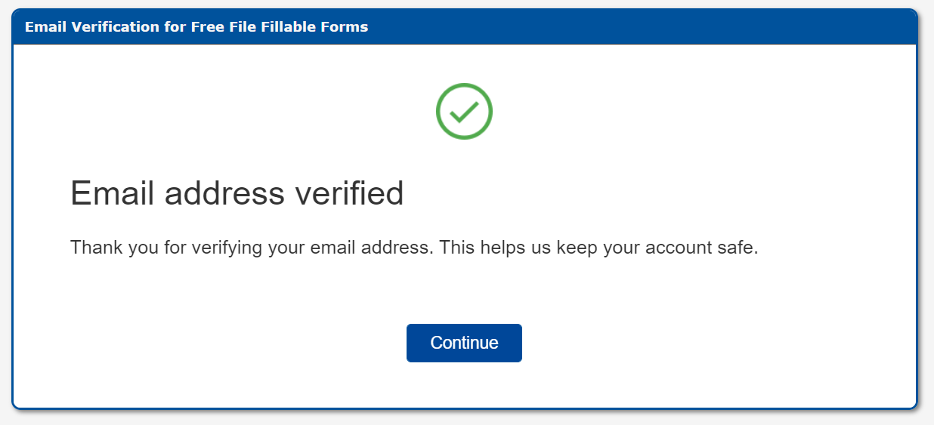
Check your email
Check your email. You will receive a message from the sender “Non-filer Sign-up Tool” with the subject line “Your Non-filer Sign-up Tool – Account”.
Click on “Confirm my account’s email address.” You will then see a confirmation screen.

Slide 44
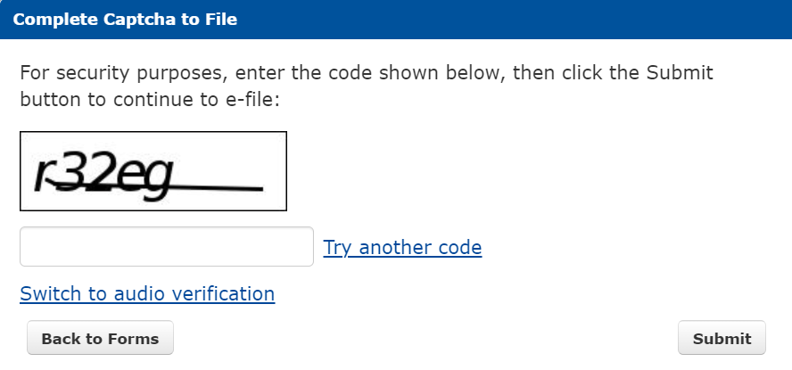
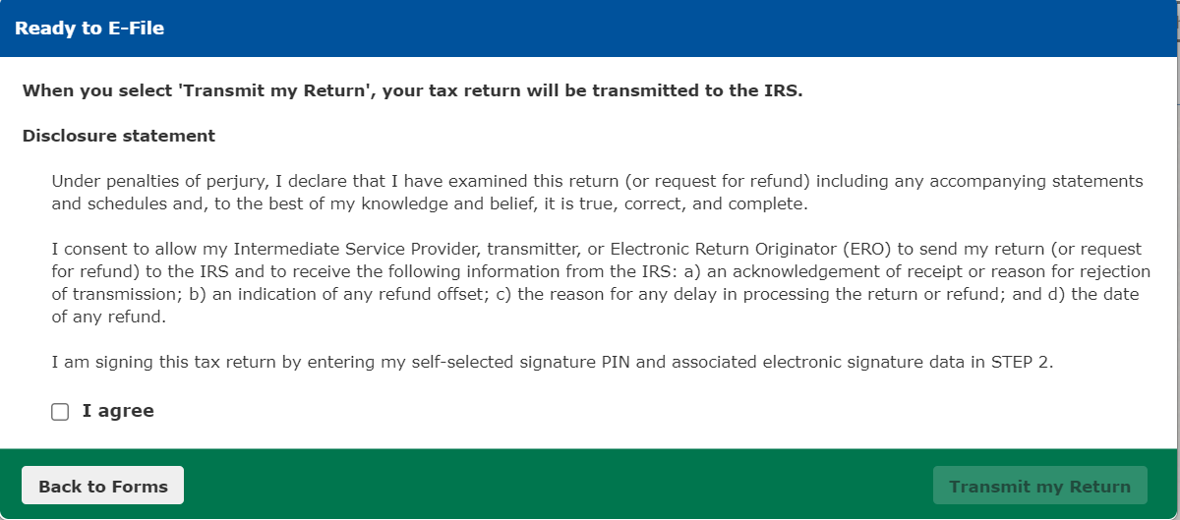
Step 6: Submit your form. Hooray!
Click the blue “Continue to E-file” button. If you’ve entered all the necessary information, you’ll see a captcha verification page. Fill in the code.
Another screen will appear with a disclosure statement. Check “I agree” and “Transmit my Return” to submit.
After you submit your form, you will receive an email to confirm successful transmission.
You’ll get a separate email acknowledging that the IRS accepted or rejected your submission. This can take up to 48 hours.
  You can also view the status of your submission at any time by signing into the Non-filer Sign-up Tool and clicking the “Check E-File Status” button.

Slide 45
IRS Child Tax Credit Update Portal Walkthrough

Slide 46
What is the Child Tax Credit Update Portal?
This portal allows you to:
Opt-out of advance payments
Change or add bank account information
Eventually, you will be able to update your:
  Income
  Marital status
  # of children
Note: to use CTC UP, you must create an account through the IRS or ID.me

Slide 47
Part 1: Creating an account

Slide 48





Getting Started
Creating an account for the CTC UP portal takes 20-30 minutes to compete if you have everything listed below.
A computer and cell phone with access to the internet (for this guide)
Full legal name
1 2 3
Photo identification: Driver’s license, State ID, Passport, or Passport Card
Your SSN or ITIN
Notes:
Photo identification: Driver’s license, State ID, Passport, or Passport Card
A computer and cell phone with access to the internet: You will need both a computer and a cell phone to create an account.
Full legal name
Your SSN or ITIN

Slide 49
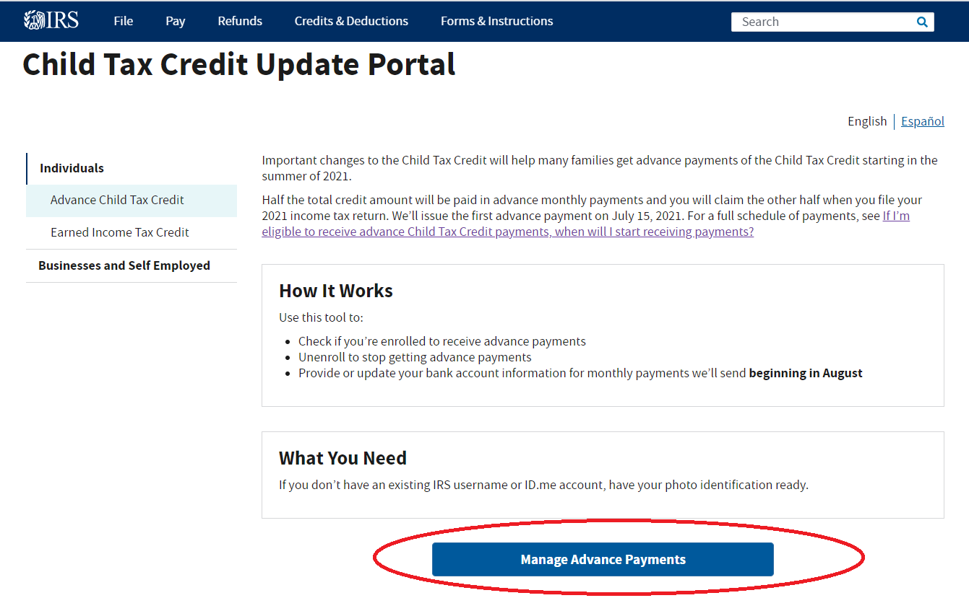
Step 1: Visit the IRS website to access the
Child Tax Credit Update Portal
Go to
https://www.irs.gov/credits-deductions/child-tax-credit-update-portal.
Click the blue “Manage Advance Payments” button.

Slide 50
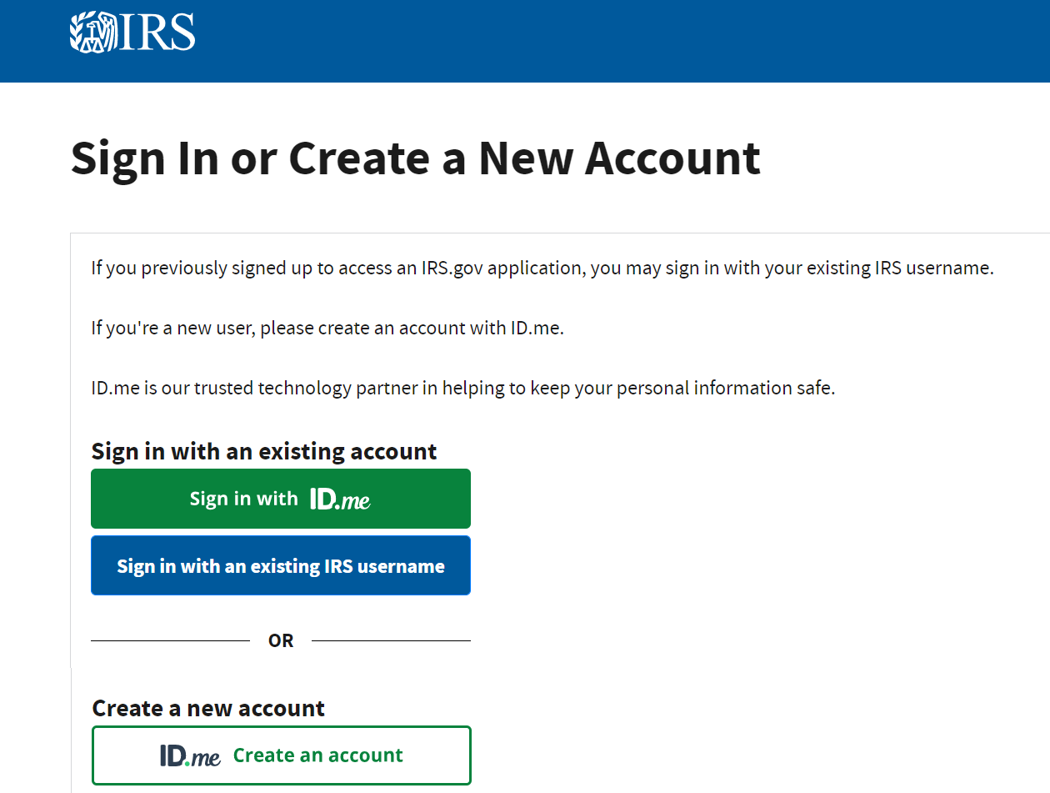
Step 2: Create an account
You will be taken to a page titled “Sign in or Create a New Account.”
If you have an IRS account already, you can just sign-in!
If you don’t, Click the “ID.me: Create an account” button. You will be taken to a new page.

Slide 51
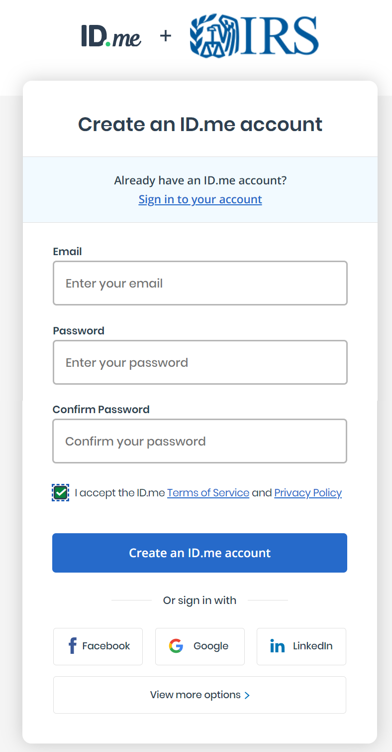
Step 3: Fill out the information to create an account
Email address: You will need to check your email to confirm your email address to successfully create an account.
Password: requires both upper- and lower-case letters, 8 characters, and a number..
Check the box “I accept the ID.me Terms of Service and Privacy Policy” after reviewing the links. Then click the blue “Create an ID.me account.”

Slide 52
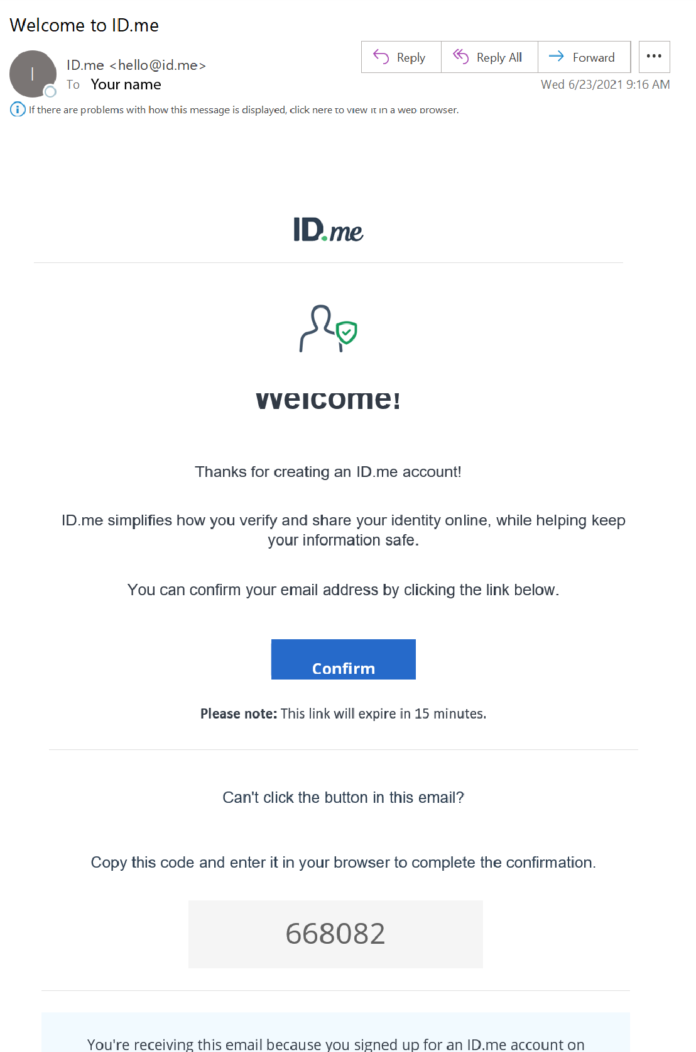
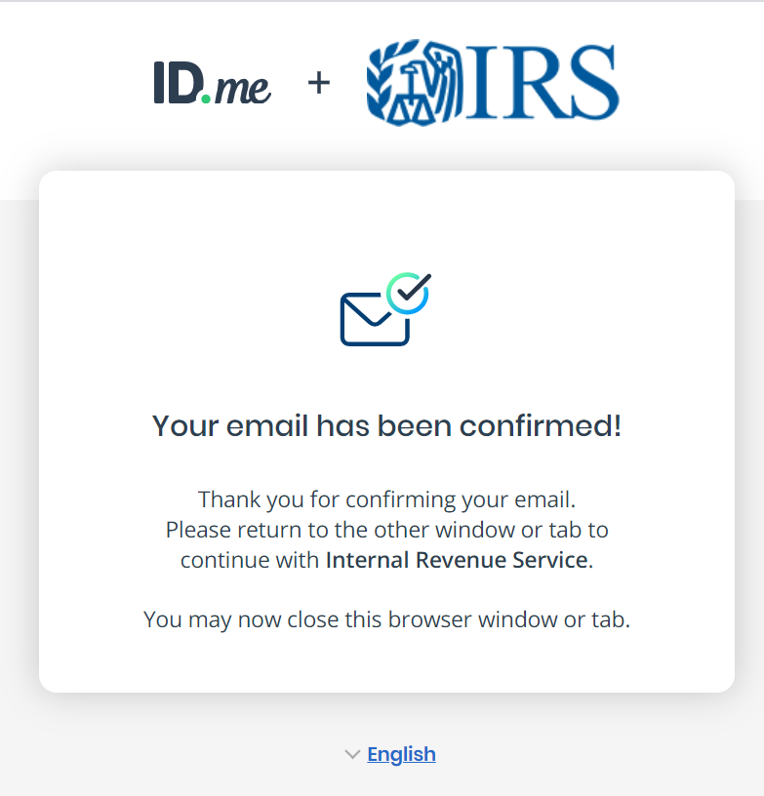
Step 4: Confirm your email address
You will receive an email from the sender “ID.me” with the subject line “Welcome to ID.me.” Click the blue “Confirm” button to confirm your email address.
When you see the confirmation screen, click the blue “Continue” button.

Slide 53
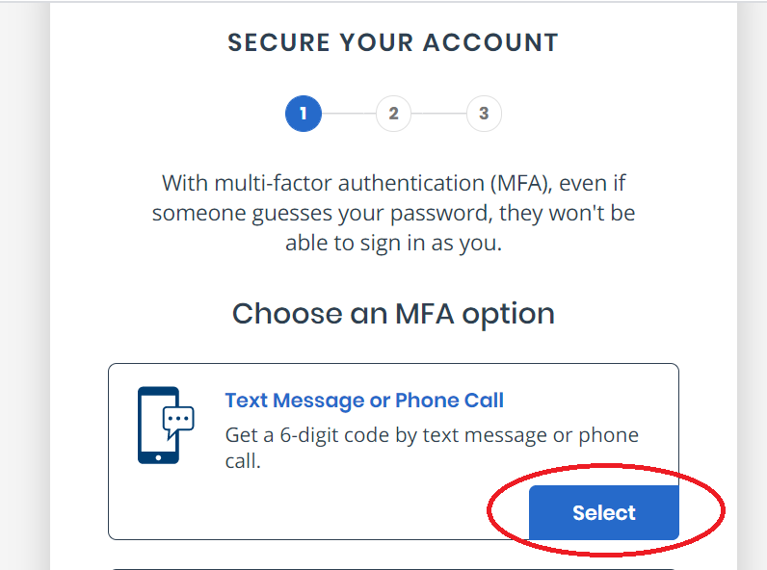
Step 5: Secure your account
After clicking the blue “Continue” button, you will be asked to secure your account. There will be five options to secure your account.
Press the blue “Select” button for “Text Message or Phone Call”

Slide 54
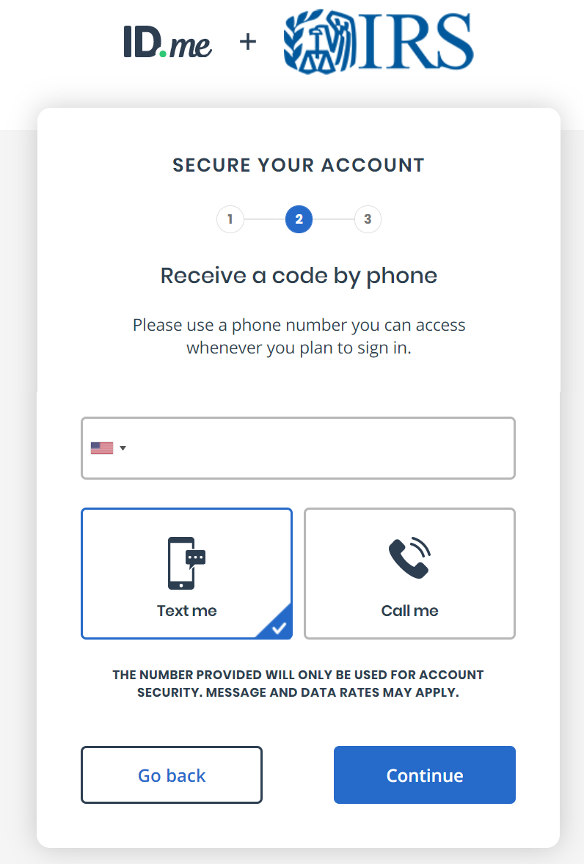
Step 6: Enter your phone number
Enter your phone number. You can choose whether to receive the security code by text message or phone call.
This guide uses the texting option.

Slide 55
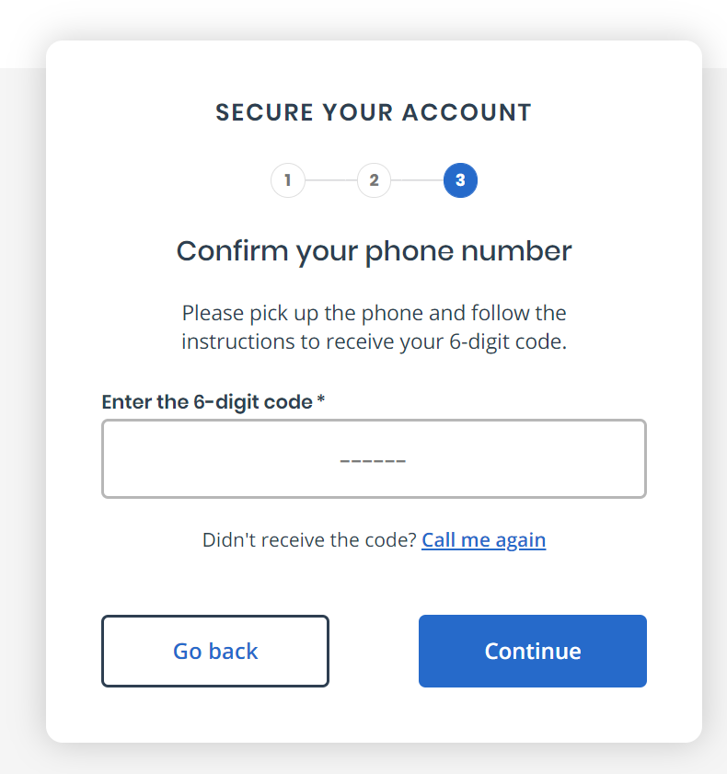
Step 7: Use the security code sent to your phone to secure your account
You will receive a text message on your phone
Enter the code in your text message onto the computer screen. Then press the blue “Continue” button. Your account is now secure!
You will be sent a confirmation email from the sender “ID.me” with the subject line “You have enabled multi-factor authentication.”

Slide 56
Steps 8 – 15: Verify your identity
You’ll need both your phone and computer.
Use your phone to take pictures of your identification document and a selfie
Enter your Social Security Number (SSN) or Individual Taxpayer Identification Number (ITIN)
Review and confirm the information on the screen matches what is on your identification document
You will receive a confirmation email and be directed to CTC UP
To verify your identity, you will need your:
1 2 3
+
Driver’s license or State ID, or Passport, or Passport Card
Your SSN or ITIN

Slide 57
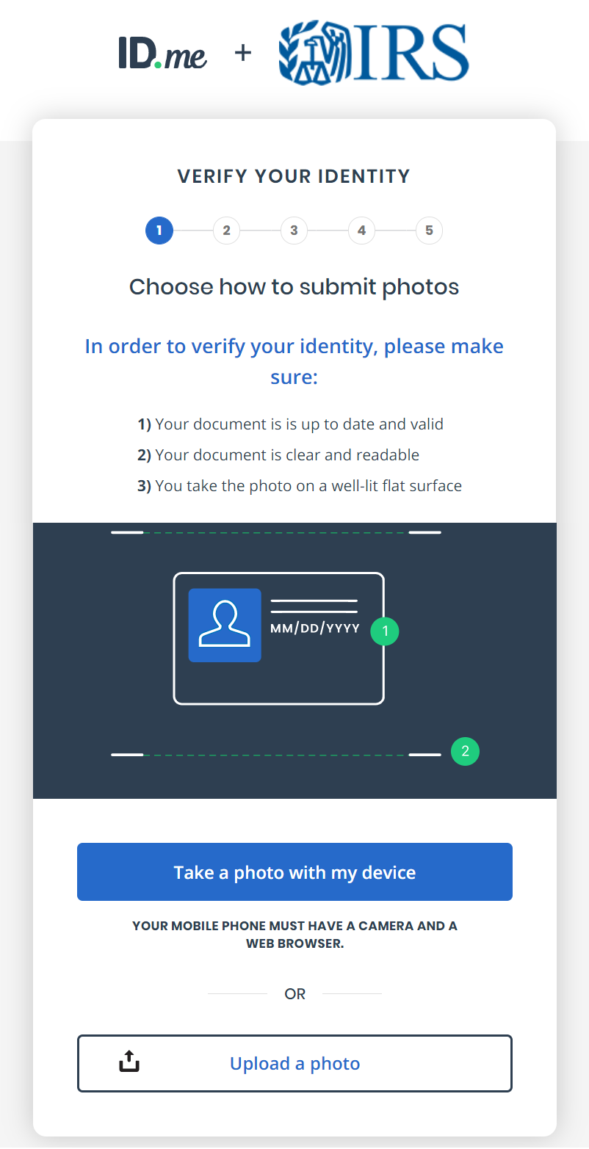
TIP: Uploading your identification document
The process to take pictures on your phone of your identification document and upload it may take awhile and may be glitchy.
You can try…
To upload your identification document by computer. You will click the “Upload a photo button.” You will need to have photos of your identification document already stored on your computer so that you can select the file and upload.

Slide 58
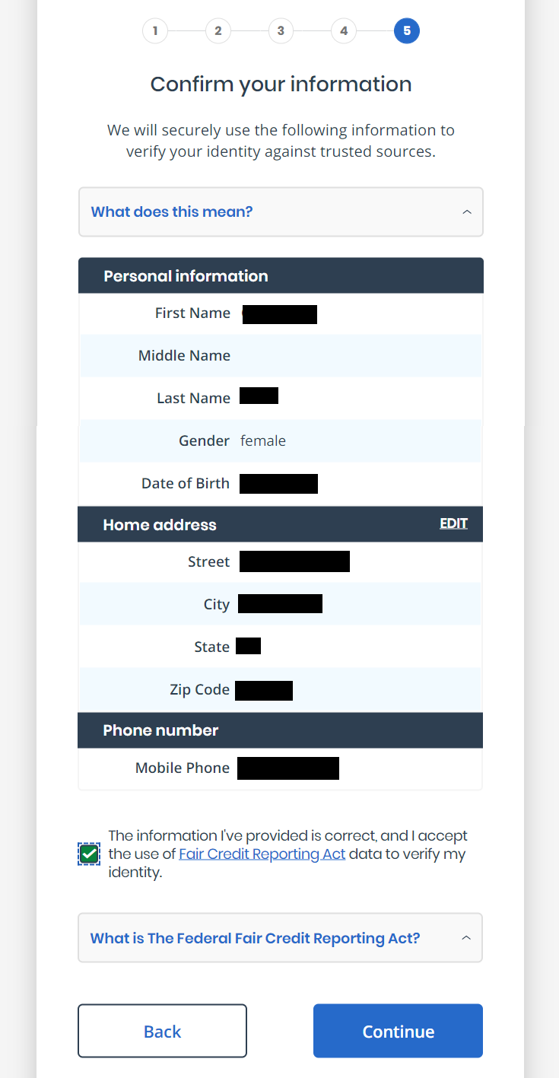
TIP: Reviewing your information
The confirmation page to review your information is NOT when you should make updates to your account.
For example: If you address has changed or you don’t have a permanent address, you can update this information in the CTC Update Portal (the function will be available later in the year)
You just want to make sure that the information on the screen matches what is printed on the identification document you uploaded.

Slide 59
Part 2: Using the Child Tax Credit Update Portal

Slide 60
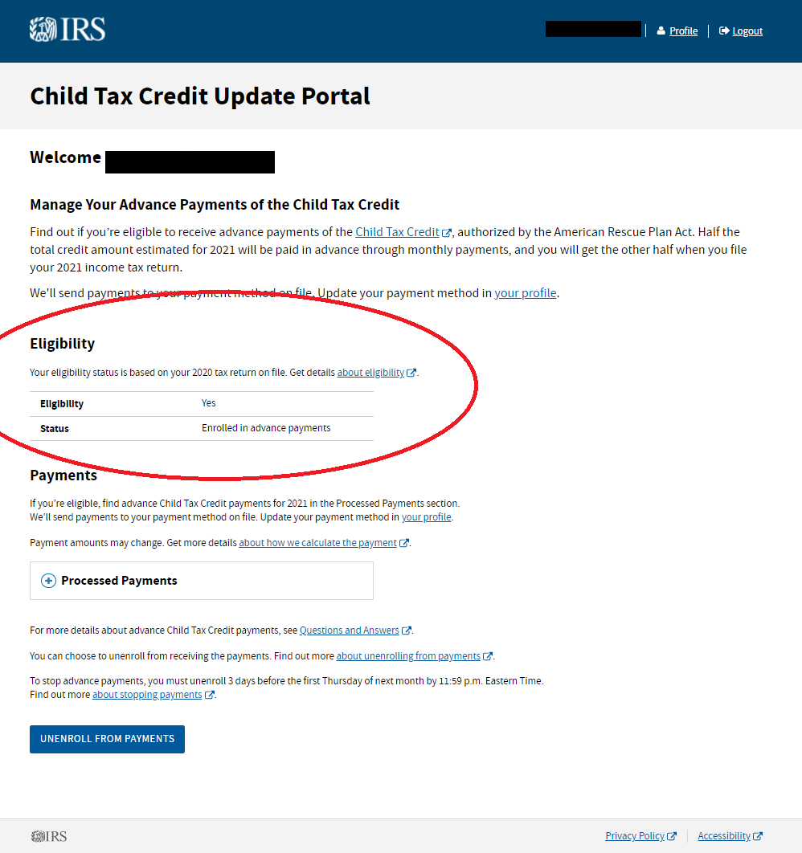
Function 1: Check your eligibility and direct deposit information
Refer to the “Eligibility” section on the main page of the Child Tax Credit Update Portal to see if you are eligible for advance payments.
The “Eligibility” box will say either “Yes” or “No.”
If you are eligible for advance payments, you can look at the “Status” box to see whether you are enrolled to receive advance payments by direct deposit.

Slide 61
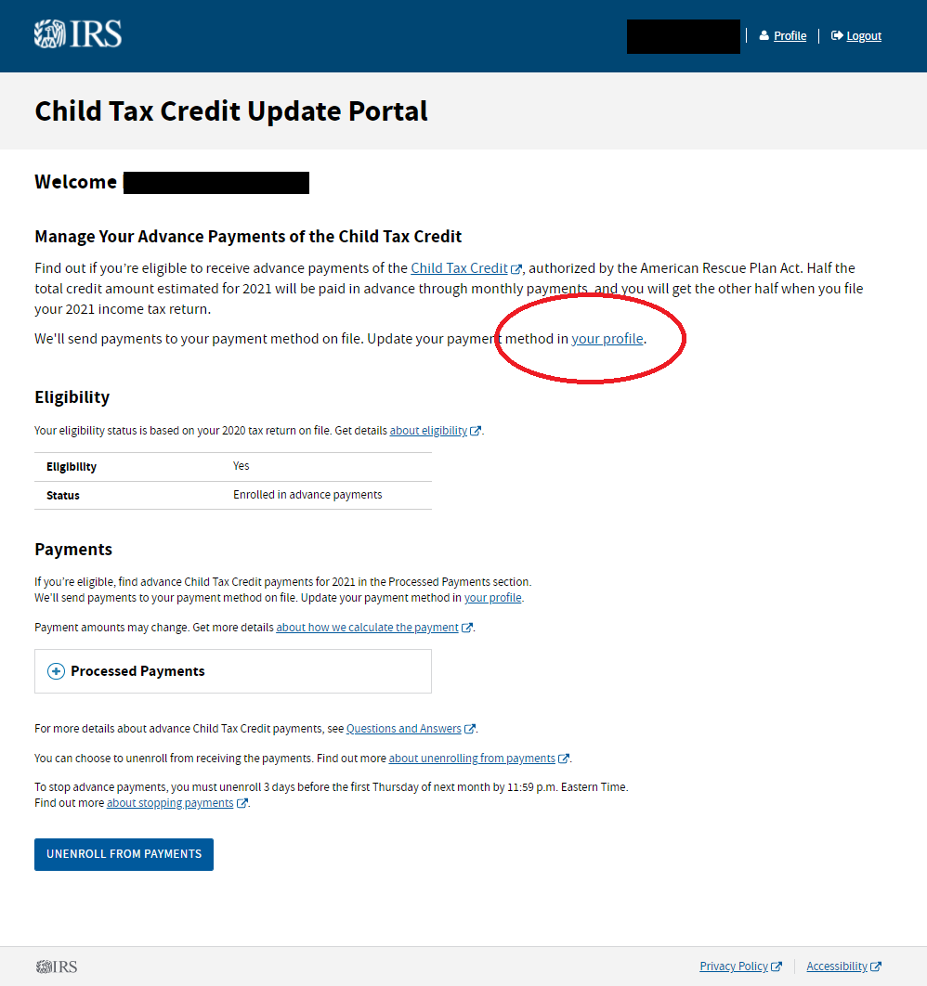
Function 2: Update your bank account information or switch from paper check to direct deposit
To see which bank account your advance payments will be sent or to switch from paper check to direct deposit, click the blue “your profile” text located at the top of the main page of the Child Tax Credit Update Portal.

Slide 62
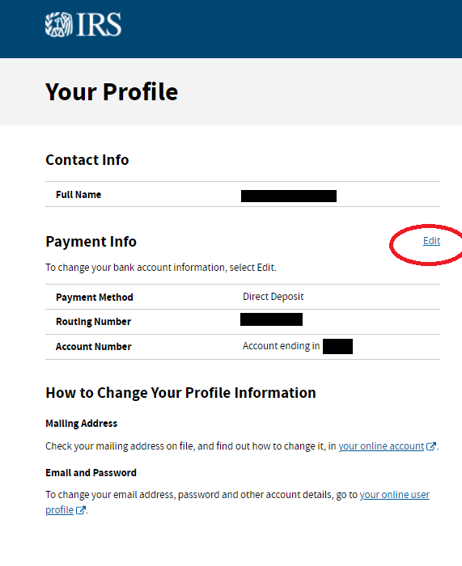
Function 2: Update your bank account information or switch from paper check to direct deposit
You will be taken to your profile page. You can see under “Payment Info” your payment method and the account that the advance payments will be sent to.
The first payment on July 15 will be sent to the bank account or mailing address that the IRS currently has on file.
  Bank account updates made by August 2 will be applied to the next payment on August 13 and to all monthly payments for the rest of 2021.
To change or add a bank account that advance payments are sent to, click the blue “Edit” text.
Note: The IRS recommends direct deposit to, “… remove the time, worry, and expense of cashing a check. In addition, direct deposit eliminates the chance of a lost stolen or undelivered check.”

Slide 63
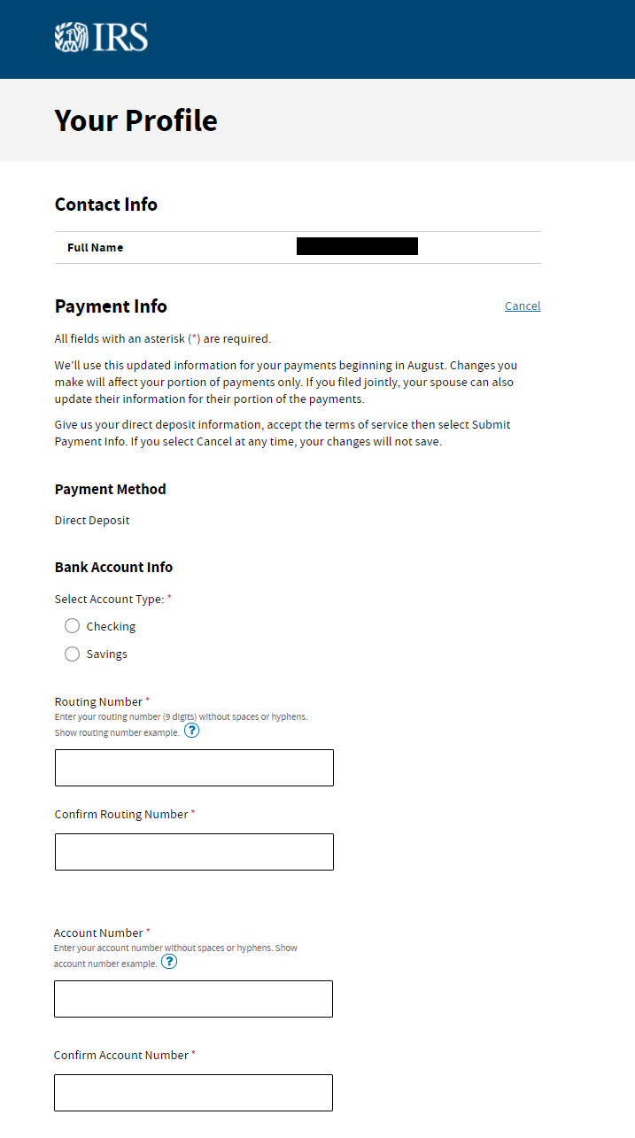
Function 2: Update your bank account information or switch from paper check to direct deposit
You will be taken to this page where you can update or add your banking information. You will need to enter your bank routing number and account number and indicate whether it is a savings or checking account.
After you are done entering your bank account information, check the box next to “I understand updates I make to this information will apply only to me.” Then click the blue “SUBMIT PAYMENT INFO” button.

Slide 64
Function 3: Unenroll for advance payments
Payment Month | Unenrollment Deadline | Payment Date
July | 6/28/2021 | 7/15/2021
August | 8/2/2021 | 8/13/2021
September | 8/30/2021 | 9/15/2021
October | 10/4/2021 | 10/15/2021
November | 11/1/2021 | 11/15/2021
December | 11/29/2021 | 12/15/2021
You can choose to unenroll from advance payments and receive all your money at once when you file your 2021 tax return (which you file in 2022).
To stop advance payments, you must unenroll according to this schedule by 11:59 p.m. Eastern Time. You don’t need to unenroll each month.
If you miss the unenroll deadline, you will get the next scheduled advance payment until your request is processed.
If you unenroll from advance payments at this time, you will be unable to re-enroll until late September 2021.
Source: IRS 2021 Child Tax Credit and Advance Child Tax Credit Payments – Q J2

Slide 65
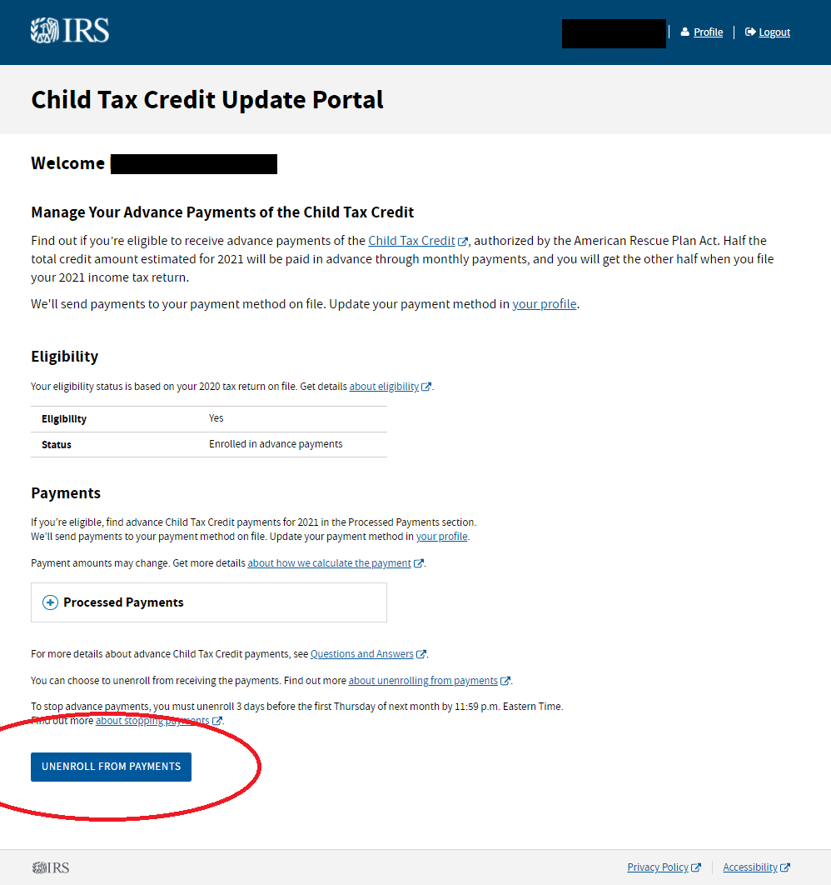
Function 3: Unenroll for advance payments
On the main page of the Child Tax Credit Update Portal, click the blue “UNENROLL FROM PAYMENTS” button.

Slide 66
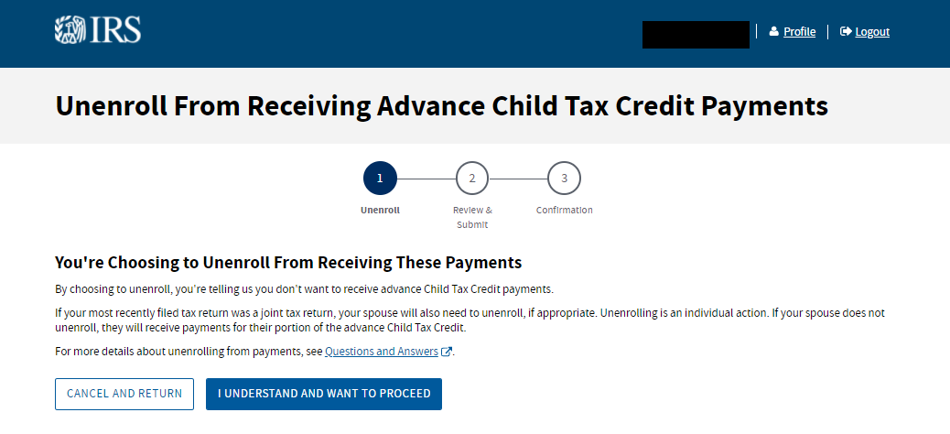
Function 3: Unenroll for advance payments
Next, after carefully reading what it means to unroll from advance payments, if you wish to continue unenrolling, click the blue “I UNDERSTAND AND WANT TO PROCEED” button.

Slide 67
Stay Connected!
CTC Outreach Resources Hub: www.taxoutreach.org/coronavirus
RESOURCES:
What’s New about the Child Tax Credit in 2021?
How to Fill out the IRS Non-filer Form
How to use the IRS Child Tax Credit Update Portal (CTC UP)
Getting Started with Outreach
UPCOMING CTC OUTREACH MATERIALS:
Customizable social media posts
Flyer and mailer
Phone and text scripts
Newsletter and press release templates
PSA script

Slide 68
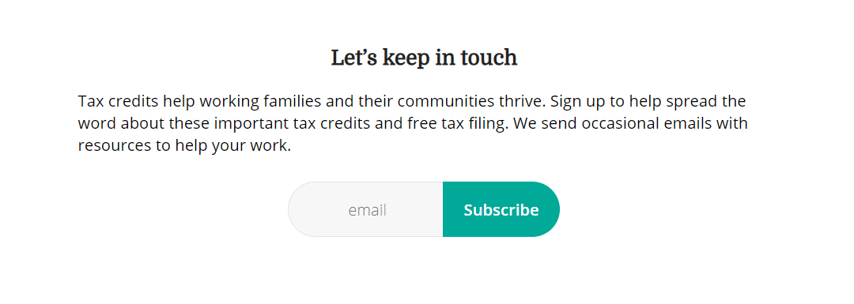
Contact Info
Get It Back Campaign
Center on Budget and Policy Priorities
eitcoutreach@cbpp.org
(202) 408-1080
www.taxoutreach.org
http://eepurl.com/gdIHn1

